Slide 1

2025/26

Slide 2
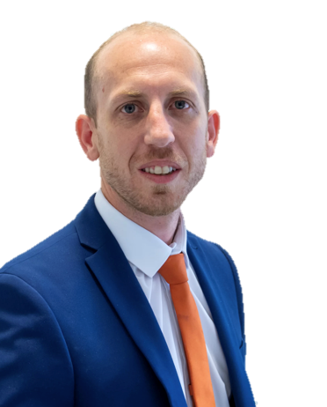

Welcome to Brooklands Primary School
A message from the Headteacher
A very warm welcome to Brooklands Primary School.
Brooklands Primary School and Nursery is at the heart of our community and strives to ensure that every child has the support, care, guidance and challenge to be the best they can be. Our fun and engaging approach, mixed with an invigorating environment and ethos, enables staff and pupils to push boundaries to be the very best they can be in all aspects of school life. We value the uniqueness in every child and celebrate this with them.
The school is proud of the strong bonds created with our children and families. This careful development is the product of nurture; our drive to develop the school’s seven values and truly going the extra mile for our children and families. The strong bonds are also reflected in our staff team, who have a ‘can do’ approach, care for each other, learn together and work well together as a high performing team. Importantly, we also know how to have fun in what we do.
OUR VALUES
Confidence
Creativity
Pride
Enjoyment
Perseverance
Aspiration
Responsibility
This handbook aims to give you a taster of the school.
If you need any further help, please do not hesitate to contact the school by emailing enquires@brooklands.derbyshire.co.uk or calling 0115 9732846
Thank you,
Mr Tom Daniel
Proud – Safe - Kind

Slide 3
The School Day
Foundation 1 | Time
Morning Session | 8.30-11.30am
Afternoon Session | 12.30-3.30pm
Foundation 2 | Time
Morning Session | 8.45-11.45am
Afternoon Session | 12.45-3.15pm
Key Stage 1 | Time
Morning Session | 8.45-11.45am
Break time | 10.45-11.00am
Lunch time | 11.45-12.45pm
Afternoon Session | 12.45-3.15pm
Afternoon break | 2.00-2.15pm
Key Stage 2 | Time
Morning Session | 8.45-12.00pm
Break time | 10.45-11.00am
Lunch time | 12.00-1.00pm
Afternoon Session | 1.00-3.15pm
Individual class timetables vary depending on the year group. Ask your child’s teacher for more information about what your child’s school day will look like.
Our assemblies are broadly Christian in nature but cover aspects of other faiths and religions as appropriate. Assemblies have a global perspective and can be related to world events, customs or situations. Our assemblies are a time for thought and reflection. Assemblies are usually linked together in a theme such as “Helping Others” or “Forgiveness”.
Every Friday, our assembly is devoted to celebrating children’s achievements. This is our ‘Star of the Week’ assembly where we celebrate children’s successes and gather as a whole school.
Our assembly days are Monday, Wednesday and Friday.

Slide 4

Attendance
Why is regular school attendance so important?
At Brooklands, we work closely with children and parents in connection with attendance so that each child can achieve their full potential. By law, all children of compulsory school age (5 to 16) must receive a suitable full-time education.
What we aim to achieve
Once your child is registered at school, you are legally responsible for making sure that they attend regularly. If your child fails to do so, you risk getting a penalty notice or being prosecuted. You also need to think about the negative impact upon the following:
- their learning
- their friendships
- their self-esteem and confidence
At Brooklands, we monitor the attendance of every child in the school, and we will work and support those children and their families who are not attending school without sufficient reason. Holidays will not be authorised during the school year.
90% attendance sounds good, but means that your child misses:
- one half day each week
- nearly four weeks every school year
- over one school year in a school career
We have set ourselves a target for the school year of 96%
Timekeeping
Timekeeping is also important in the education of your child. If your child is persistently late, they are missing out on important learning opportunities at the start of the lesson. The school day starts promptly at 8.45am. Equally, it is really important to pick your child up on time to avoid unnecessary worry on their part and not to delay staff, who often have meetings or training events after school. Our school day finishes at 3:15pm.
What are we doing to improve attendance?
Attendance of all pupils is monitored weekly and those falling below 90% are informed by letter at the end of each half term, which is then reviewed regularly. Throughout the year our senior leadership team and our family support team work closely with families providing support to help overcome barriers in improving attendance. The Local Authority takes attendance issues very seriously and any family who continues to be a concern will be referred to a specific team within the Local Authority who look into these issues. This service is also triggered by children who have repeated unauthorised absences.
At Brooklands we like to encourage and praise children who attend school regularly:

Slide 5

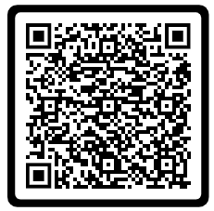
Medical and Illness Information
For the prevention of illness spreading please keep your child out of school for 48 hours after the last time they have vomited.
We are not allowed to give any medicines in schools without WRITTEN CONSENT, and doses given are recorded.
Our First Aid Policy can be found by scanning the QR code
The following guidelines have been taken from the Gov.UK website.
If you are unsure whether your child can return to school, please
contact the school office.
Chickenpox
At least 5 days from the onset of the rash and until all blisters have crusted over.
Diarrhoea and Vomiting
48 hours after their last episode.
Cold and flu-like illness (including COVID-19)
Pupils no longer have a high temperature and feel well enough to attend. Follow the national guidance if they’ve tested positive for COVID-19.
Impetigo
Their sores have crusted and healed, or 48 hours after they started antibiotics.
Measles
4 days after the rash first appeared.
Mumps
5 days after the swelling started.
Scabies
They’ve had their first treatment dose.
Scarlet Fever
24 hours after they started taking antibiotics.
Whooping cough
48 hours after they started taking antibiotics.

Slide 6
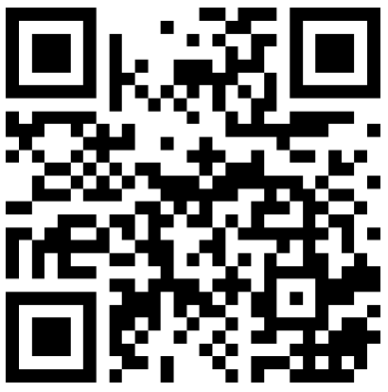

Communication
Regular, effective and consistent communication between school and home and vice versa is fundamental to our children’s success in school, as such, we use Class Dojo as a major part of our behaviour and communication policy.
Parents/carers are invited to download the app onto their phones or tablets to access information shared by your child’s class teacher or whole school information.
Visit: https://www.classdojo.com/download/
or scan the QR code
Class Dojo has many features, including:
Messaging: Communicate with teachers & staff anytime, anywhere—with read receipts, scheduling, and instant translations.
Stories: Teachers & staff can share photos, videos & updates on a private feed to give everyone a window into the school day—safely and securely.
Events: Teachers & staff can add events to the calendar so that it is easy to keep everyone in the loop with automatic reminders.
You can send us messages on Class Dojo during the school week. We will endeavour to respond within 24 hours; however, we will only respond between 8am-4pm.
Please note that Class Dojo should be used for general communication with your child’s class teacher. If you have an important or serious issue, please contact the school office or arrange a meeting with the class teacher, rather than communicate these through Class Dojo.

Slide 7
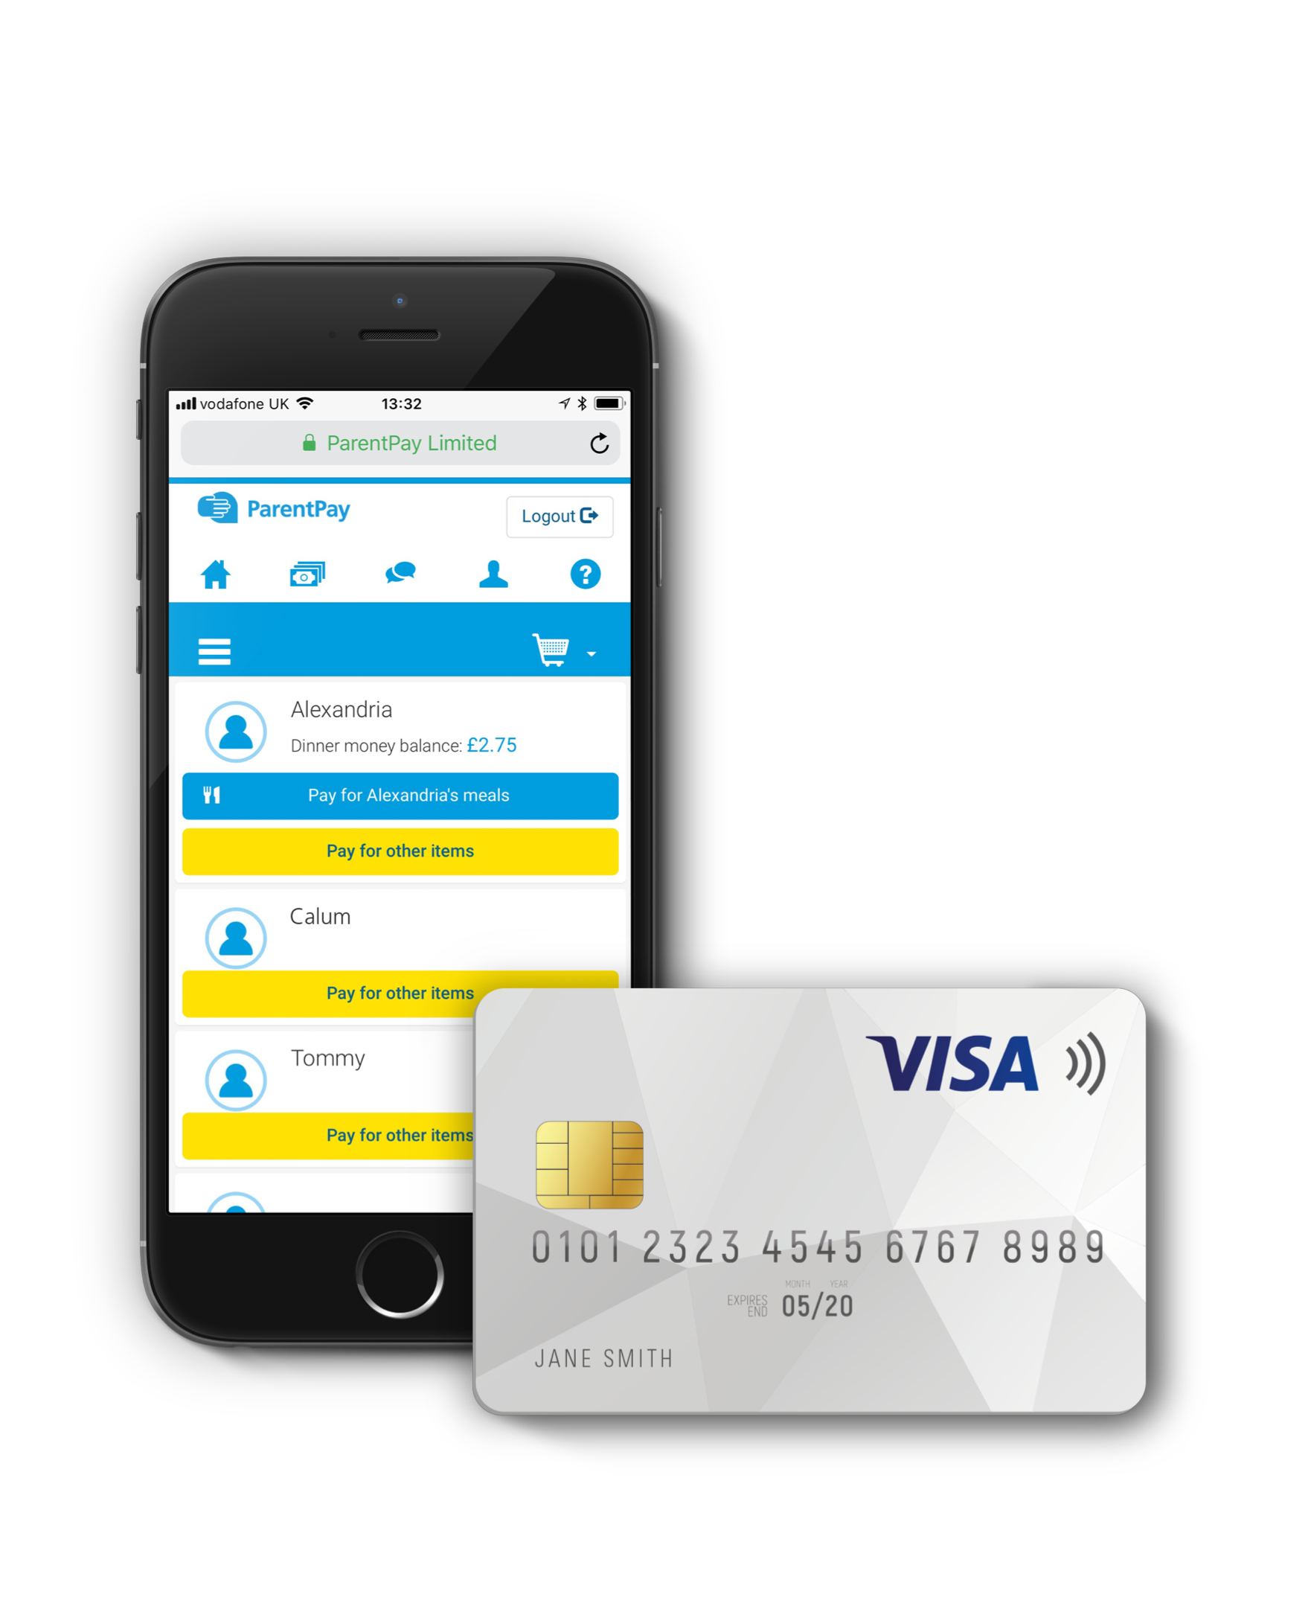
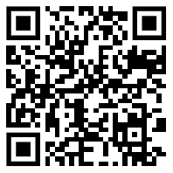
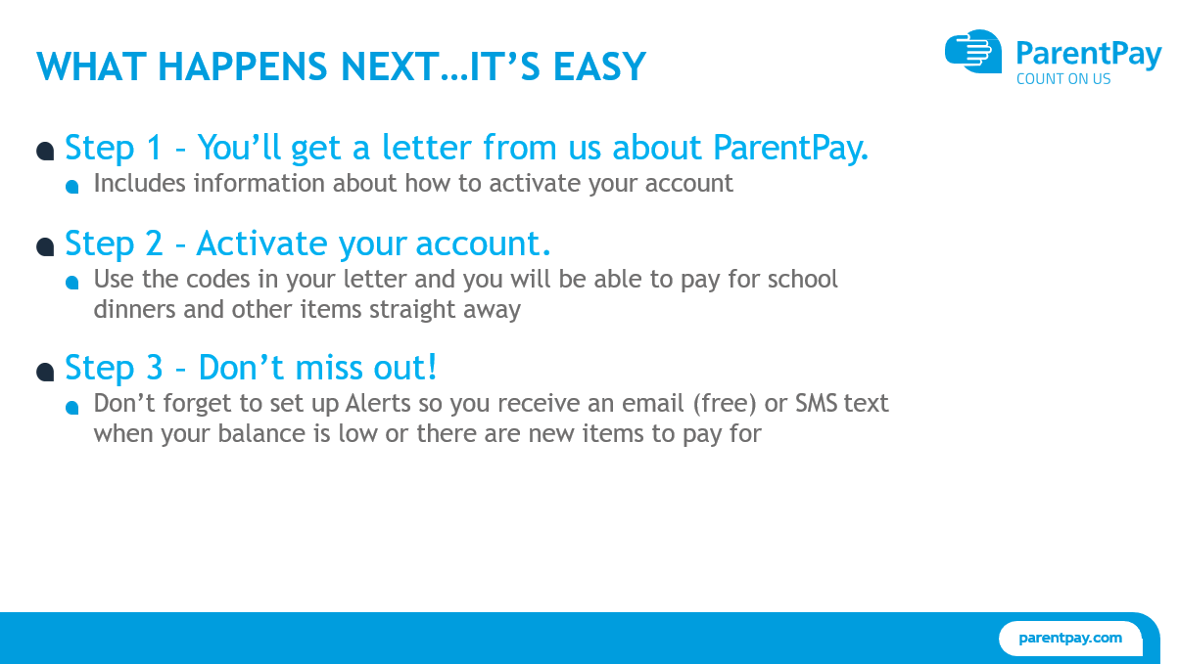
ParentPay
All lunches, school trips, breakfast club, afterschool club and residentials should be paid through ParentPay.
Once we have your mobile number and email address, we will send you a welcome message enabling you to log in.
You can access the ParentPay website by scanning the QR code with your mobile phone camera.

Slide 8

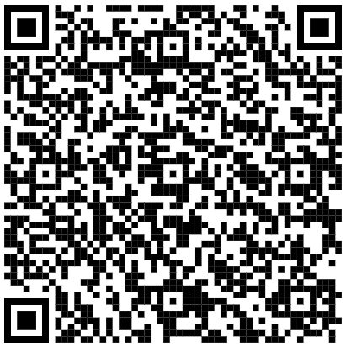
School Meals
School dinners are cooked on the premises in our school kitchen.
A school dinner represents excellent value for money and currently costs £3.25 per day.
If you wish your child to have a meal cooked by school, please contact the office to ensure you have log in details for ParentPay.
Food and Drink
We are a Nut Free School
Due to the increasing number of children with allergies to nuts, school have taken the decision to be a Nut Free School. Please do not add nuts or items that contain nuts (chocolate spread, chocolate bars with nuts in them etc) to your child’s lunch box.
We also have some children in school who are allergic to sesame. Like all allergens, we actively try to reduce the amount within school (i.e through eliminating in our school menu). We are asking that you try to avoid any food containing sesame within your child’s lunchbox. Foods containing sesame seeds include tahini, hummus, crackers, breads, bread sticks, burger buns, salads, cereal (health) bars, gomashio, halvah and falafel.
Scan the QR code for more information
about sesame seed allergies.
Thank you for your support.

Slide 9

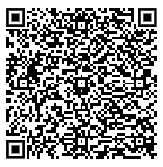
Allergies and Special Diets
At Brooklands, our school menu is provided through Derbyshire Catering Service.
Pupil wellbeing is a priority at Derbyshire Catering Service.
They provide tailored menus for a wide range of medically diagnosed dietary needs, including all 14 major allergens.
Medical Diet Application Form
Derbyshire Catering Service provides tailored medical diets for pupils with medically diagnosed dietary needs.
The form is simple to use - create an account and upload the medical documentation relating to your child’s condition. This helps us prepare safe, appropriate meals for every pupil.
Scan the QR code for direct access to the medical form, alternately visit this website:
https://www.schoolmeals.derbyshire.gov.uk/allergies-and-special-diets/allergies-and-special-diets.aspx

Slide 10


Free School Meals

Slide 11
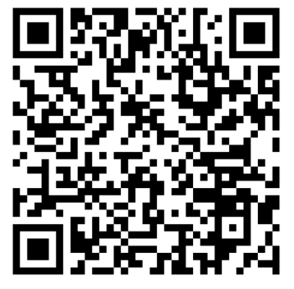

Breakfast Club & After School Club
The Lime Trees are Brooklands before and afterschool providers.
This club provides full wrap around care for our working families.
The Lime Trees
As an Outstanding childcare provider, The Lime Trees’ mission is rooted in helping and supporting each individual family. We recognise that every child, every family and every home is unique, and our aim is to deliver a service that we, as parents, would be proud to use. We realise that flexibility and affordability of childcare is essential to meet the needs of modern family life. That’s why our session times and booking software are designed to allow you to manage the care of your children around your schedule and not the other way around!
How to book
We provide a totally flexible service, which gives you the option to book the sessions that work best for you and your family via our online booking system. Bookings are now open . Simply visit our website www.thelimetrees.co.uk and select the ‘Book Now’ option from the top left drop-down menu. Choose your desired location and click ‘Book Now’. You will need to register your child/children before you are able to make a booking. For more information on how to register, book your place and make a payment as well as some general FAQs, please refer to the ‘Parents Guide’ which can be found on our website.
Keep in touch and stay up to date
If you have any immediate questions, please refer to our website for our ‘Parent Guide’ or scan the QR code below. Alternatively, you can contact us on 0115 9313 562 or email hello@thelimetrees.co.uk. For all the latest news and promotions follow us on Facebook and Instagram - just search for The Lime Trees.
 | Breakfast Club | After School Club
Time | 7.30am – 8.30am | 3.10pm- 6pm
Cost | £5.75 | £9.75
Location | The Aviary is located in the Junior Building and is next to the Osprey classroom.

Slide 12
School Uniform
There is a school dress code, in which we hope all parents will encourage children to take pride.
Our branded school uniform can be purchased online by visiting:
My Clothing: https://myclothing.com/collections/brooklands-primary-school-28215
Email: support@myclothing.com
Telephone: 0800 0590594
Alternately, you can visit TGR Embroidery:
TGR Embroidery:
Unit 1,
Nottingham Road
Attenborough
Nottingham
NG9 6DN
Uniform Expectations:
Grey, black or navy – shorts, trousers, culottes, skirts or pinafore dress
White polo shirt – with or without logo
Navy jumper, cardigan or sweatshirt – with or without logo
Checked navy and white summer dress – Summer Term Only (After Easter)
Black sensible shoes or boots – no trainers
Navy book bag – From TRG embroidery
PE Expectations (Children to wear PE kits on their PE days, not school uniform):
Navy PE Bag (also available at TRG embroidery)
Black or navy shorts or leggings
Plain white t-shirt – with or without logo
Plain dark trainers (No logo or branding and preferably Velcro) or plimsolls
Navy jogging bottoms –Winter
Navy zip hoodie – with or without logo – for winter
Optional Extras:
Navy reversible fleece
Navy coat with logo
Sunhats – with logo
Nursery:
Whilst uniform is not compulsory for our Nursery children, we would strongly recommend it. This helps children become ‘school ready.’
Jewellery:
The only jewellery allowed is one pair of stud earrings and a non-smart watch.
Website: tgr-embroidery.co.uk
Email: info@tgr-embroidery.co.uk
Telephone: 07952192899 (Teresa) or 07722046693 (Gary)

Slide 13
Term Dates 2025/26
Here are a list of dates that have been fixed for the year. There will be other events that happen throughout the year, these will be shared in your child’s year group newsletter or on Class Dojo.
Date | Event
Thursday 4th September | INSET DAY
Friday 5th September | INSET DAY
Monday 8th September | Children return to school for the start of Autumn 1
Friday 3rd October | Individual school photographs
Friday 24th October | Last day of Autumn 1
Monday 3rd November | Children return to school for the start of Autumn 2
Friday 19th December | End of Autum Term
Monday 5th January | INSET DAY
Tuesday 6th January | Children return to school for the start of Spring 1
Friday 13th February | Last day of Spring 1
Monday 23rd February | Children return to school for the start of Spring 2. This is potentially an INSET DAY – needs to be confirmed.
Friday 27th March | End of Spring Term
Monday 13th April | Children return to school for the start of Summer 1
Monday 4th May | Bank Holiday
Friday 22nd May | Last day of Summer 1
Monday 1st June | INSET DAY
Tuesday 2nd June | Children return to school for the start of Summer 2
Thursday 23rd July | Last day of Summer Term

